Slide 1
Chapter 5 Entity–Relationship Modeling

Slide 2
Entity Types
A group of objects with the same properties, which are identified by the enterprise as having an independent existence.
Entity occurrence A uniquely identifiable object of an entity type.
Entity

Slide 3
Relationship Types
A relationship type is a set of associations between one or more participating entity types.
Each relationship type is given a name that describes its function.
An arrow symbol is placed beside the name indicating the correct direction for a reader to interpret the relationship name (for example, Branch Has Staff)

Slide 4
Relationship Types
Each relationship type is shown as a line connecting the associated entity types, labelled with the name of the relationship. Normally, a relationship is named using a verb (for example, Supervises or Manages) or a short phrase including a verb (for example, LeasedBy).

Slide 5
Degree of Relationship Type
The entities involved in a particular relationship type are referred to as participants in that relationship. The number of participants in a relationship type is called the degree of that relationship.
A relationship of degree two is called binary.
A relationship of degree three is called ternary.
A relationship of degree four is called quaternary.

Slide 6
Degree of Relationship Type
The UML notation uses a diamond to represent relationships with degrees higher than binary. The name of the relationship is displayed inside the diamond and in this case the directional arrow normally associated with the name is omitted.
Relation

Slide 7
Recursive Relationship
A relationship type where the same entity type participates more than once in different roles.
Consider a recursive relationship called Supervises, which represents an association of staff with a Supervisor where the Supervisor is also a member of staff.

Slide 8
Recursive Relationship
Relationships may be given role names to indicate the purpose that each participating entity type plays in a relationship.
Role names can be important for recursive relationships to determine the function of each participant.

Slide 9
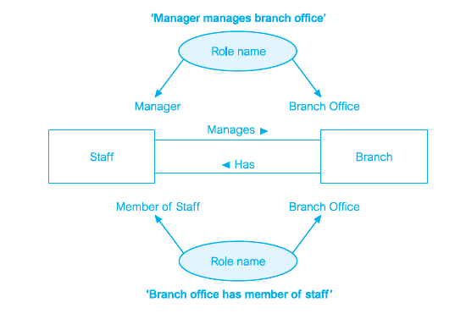
Recursive Relationship

Slide 10
Attributes
The particular properties of entity types are called attributes.
The attributes hold values that describe each entity occurrence and represent the main part of the data stored in the database.

Slide 11
Simple and Composite Attributes
Simple attributes cannot be further subdivided into smaller components. Examples of simple attributes include position and salary of the Staff entity.
Some attributes can be further divided to yield smaller components with an independent existence of their own.

Slide 12
Single-Valued and Multi-Valued Attributes
An attribute that holds a single value for each occurrence of an entity type.
An attribute that holds multiple values for each occurrence of an entity type.
A multi-valued attribute may have a set of numbers with upper and lower limits. For example, the telNo attribute of the Branch entity type has between one and three values.

Slide 13
Derived Attributes
An attribute that represents a value that is derivable from the value of a related attribute or set of attributes, not necessarily in the same entity type.

Slide 14
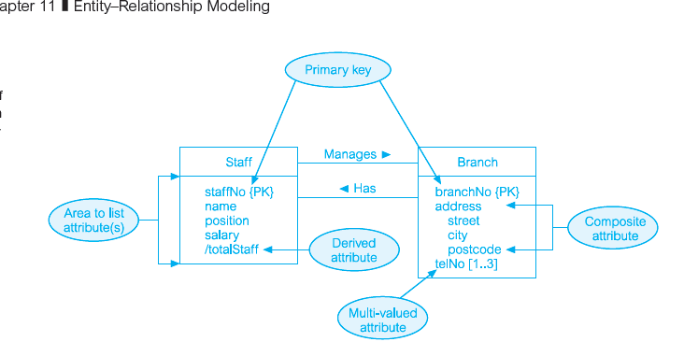
Keys

Slide 15
Strong and Weak Entity Types
Strong entity type
An entity type is referred to as being strong if its existence does not depend upon the existence of another entity type.
A characteristic of a strong entity type is that each entity occurrence is uniquely identifiable using the primary key attribute(s) of that entity type.

Slide 16
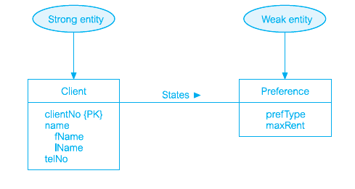
Strong Entity

Slide 17
Weak Entity
A weak entity type is dependent on the existence of another entity type.
A characteristic of a weak entity is that each entity occurrence cannot be uniquely identified using only the attributes associated with that entity type.

Slide 18
Structural Constraints
The main type of constraint on relationships is called multiplicity.
Multiplicity constrains the way that entities are related. It is a representation of the policies (or business rules) established by the user or enterprise.
Ensuring that all appropriate constraints are identified and represented is an important part of modeling an enterprise.

Slide 19
Multiplicity
the most common degree for relationships is binary. Binary relationships are generally referred to as being
one-to-one (1:1),
one-to-many (1:*),
many-to-many (*:*).

Slide 20
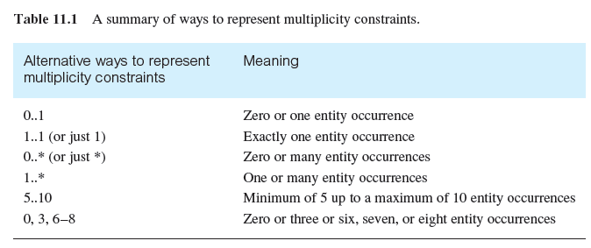
Represent Multiplicity Constraints.

Slide 21
Cardinality and Participation Constraints
Multiplicity actually consists of two separate constraints known as cardinality and participation.
Cardinality Describes the maximum number of possible relationship occurrences for an entity participating in a given relationship type.
The cardinality of a relationship appears as the maximum values for the multiplicity ranges on either side of the relationship.

Slide 22
Cardinality and Participation Constraints
The participation constraint represents whether all entity occurrences are involved in a particular relationship (referred to as mandatory participation) or only some (referred to as optional participation).
Optional participation is represented as a minimum value of 0 while mandatory participation is shown as minimum value of 1.

